Slide 1

Swedish Armed Forces
M&S Capabilities and Plans
JTLS-GO IUC 2025
Presented by
Lieutenant Colonel (M) Ulf Hassgård
Swedish Armed Forces Defence Staff
Training & Exercise Department

Slide 2
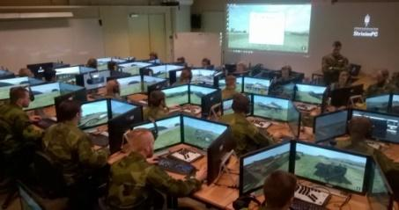
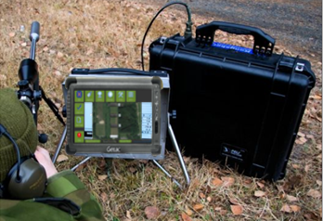
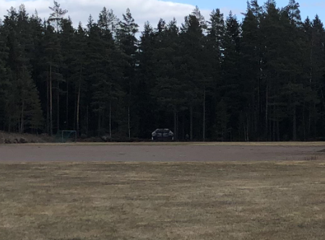
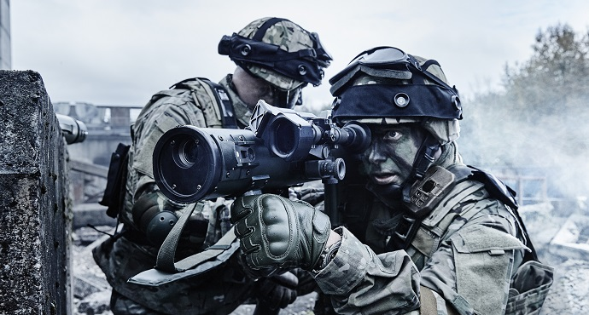
M & S Doctrine
Decentralized
- ”Home station training”
Interoperable
- Systems
- Country, partners
”Few train many”
- Focus on the trainer/ instructor
”In house”
Limit numbers of contractors
Education
Training
Practicing
Testing
Evaluating
Classroom
Lanes
Force on Target
Force on Force
Classroom
Live and Simulators
Focus on the Tactical Level

Slide 3
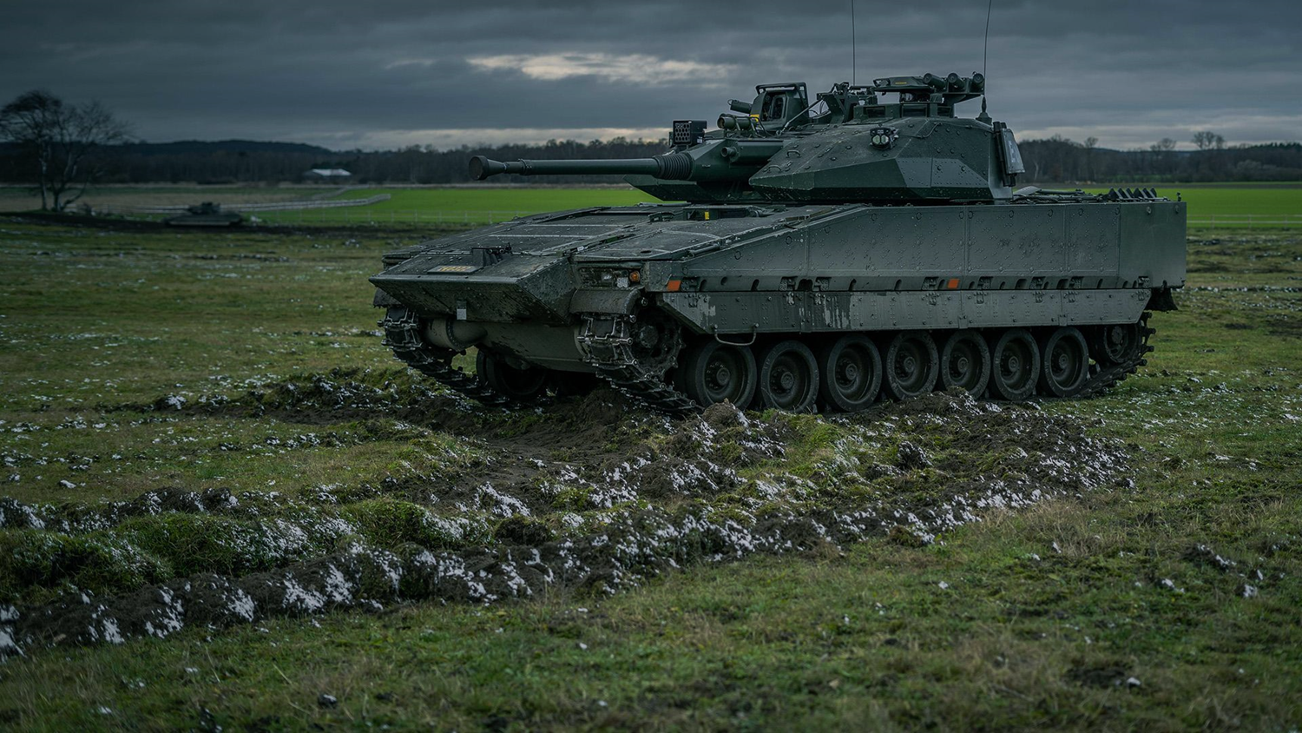
M & S Capabilities in the
Swedish Armed Forces
Military Strategic Level Capabilites
Operational Level Capabilities
Tactical Level Capabilities
  LTA – CAX-facilities for training battalion and brigade level commanders and staffs
  STA – Live training support facilities for training units up to company level
  StriSimPC – Classroom or mobilie training of soldiers and units up to company level
A vast array of tactical training systems

Slide 4
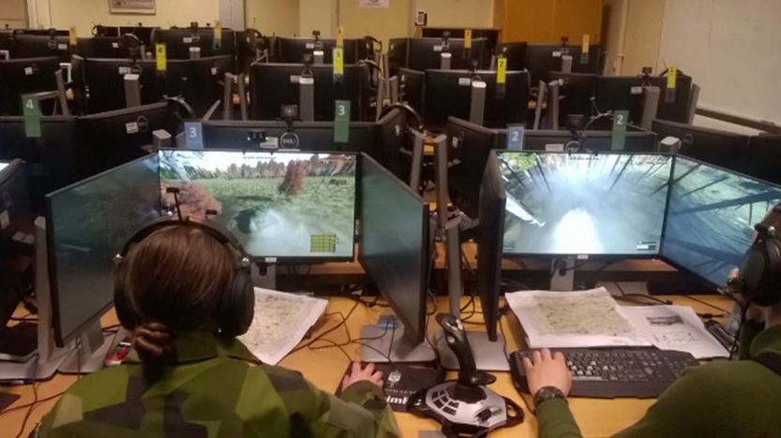
LTA – Tactical Level Computer Aided Exercise Facilities
LTA – CAX facilities for training battalion and brigade level commanders and staffs
  6 facilities

Slide 5
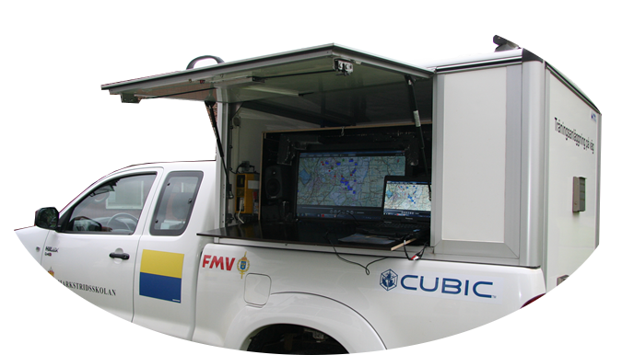
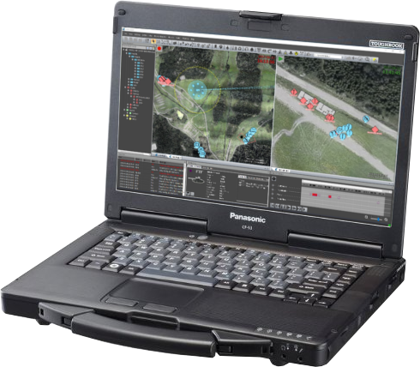
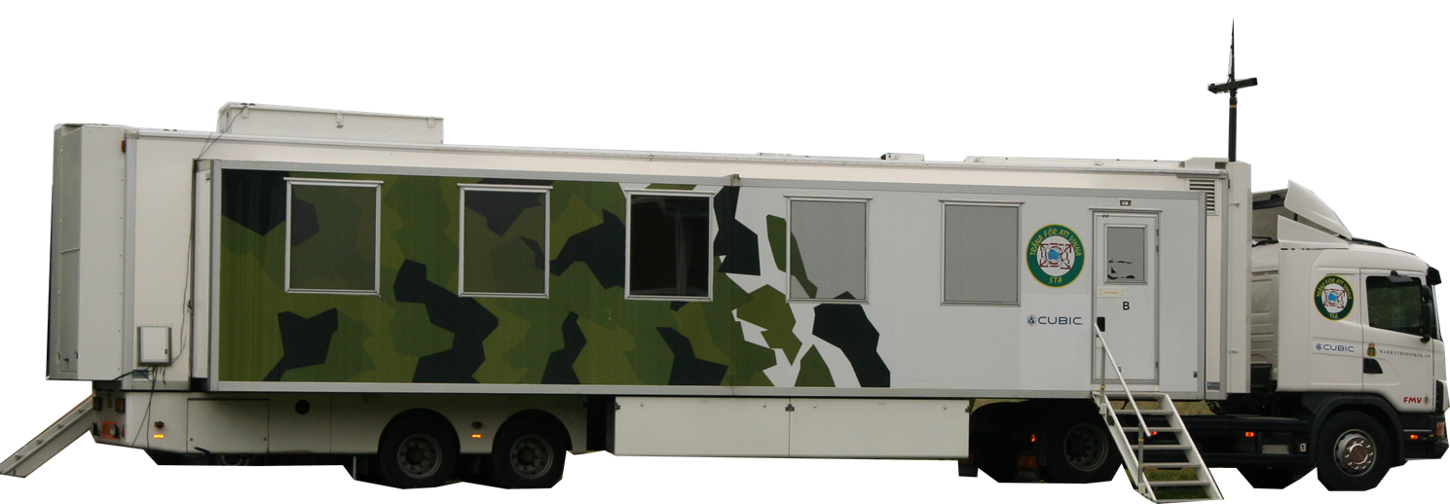
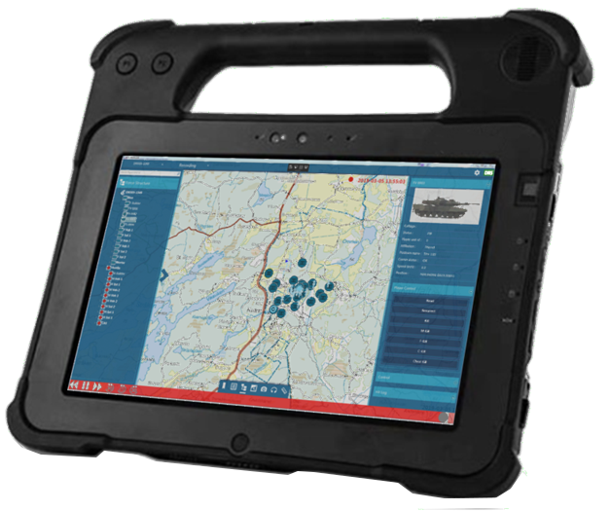
STA – Exercise Control
STA – Tactical Level Live Exercise Support
+
Mobile AAR
Excon
Mobile Clients
OC Tablets
Platoon Excon

Slide 6
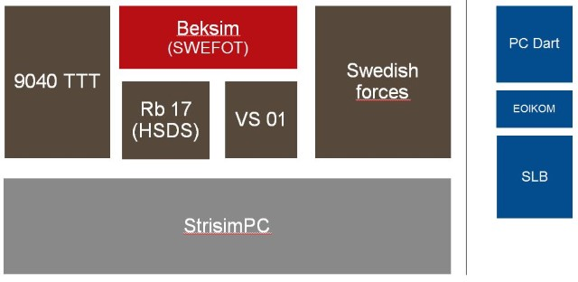
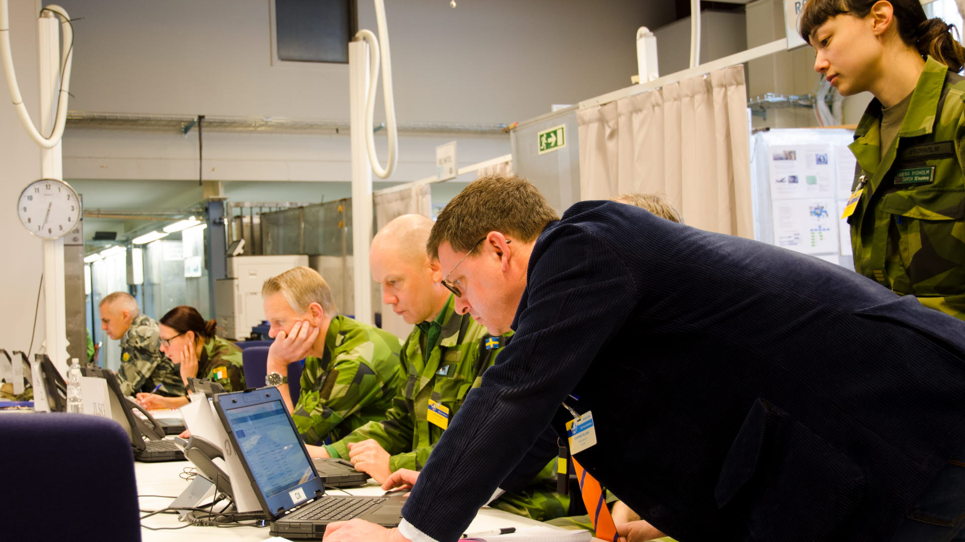
StriSimPC
StrisimPC is a system for simulating combat environment and scenarios to develop and maintain soldiers, commanders and units war fighting capabilities
Swedish Armed Forces have 19 systems; can be linked together to train up to 800 soldier or units
Used in barracks and for mobile training
3D global map, for the Swedish territory with high resolution
Virtual BattleSpace 4 (VBS4) and VBS Radio software

Slide 7
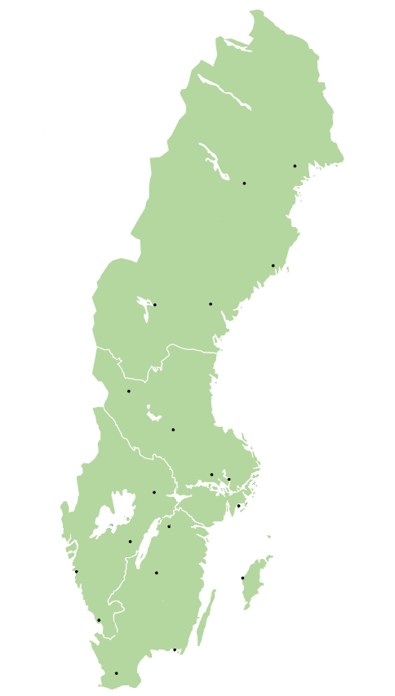
Regiments/Flottillas
Brigades
I 19
K 4
SkyddC
I 21
Boden
Brigade
LTA
X
I 13
LG
LedR
Kungsängen
Brigade
LTA
Amf 1 (M)
A9
Enköping
Division
LTA
MSS Kvarn
Hkpflj (AF)
K 3
Tofta
Brigade
LTA BAT
X
P 4
F 7 (AF)
Skövde
Brigade
LTA BAT
X
Amf 4 (M)
Ing 2
X
P 18
Revinge
Brigade
LTA
Lv 6
X
SSS
P 7

Slide 8

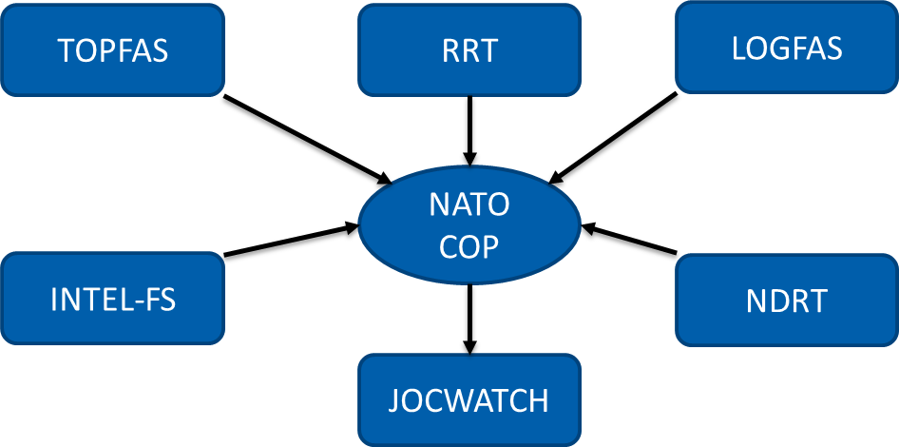
What’s missing?
Modern M&S support for Military Strategic and Operational Levels
The Swedish Armed Forces have a long history of M&S support for the Viking Exercise Series
  Unclassified level exercises
  Fictional scenarios and plans
  Fictional areas of operations
  Temporary organised units, commanders and staffs
The changed strategic environment creates new demands
  Classified level exercises
  Real scenarios and plans
  Real areas of operations
  Actual units, commanders and staffs

